Slide 1
Section 7.5
Unit Circle Approach;
Properties of the Trigonometric Functions
Copyright © 2012 Pearson Education, Inc. Publishing as Prentice Hall.

Slide 2
Copyright © 2012 Pearson Education, Inc. Publishing as Prentice Hall.

Slide 3
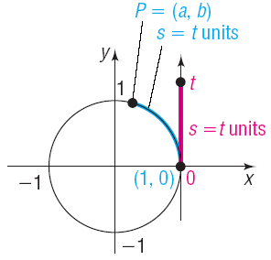
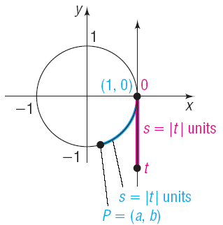
Copyright © 2012 Pearson Education, Inc. Publishing as Prentice Hall.

Slide 4
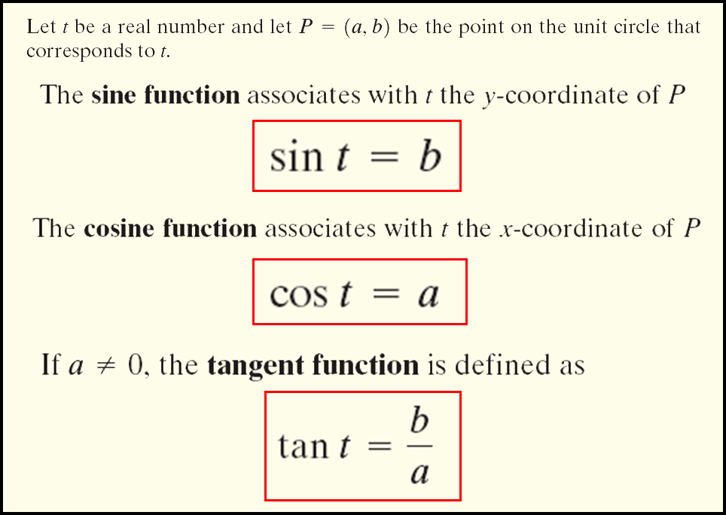
Copyright © 2012 Pearson Education, Inc. Publishing as Prentice Hall.

Slide 5
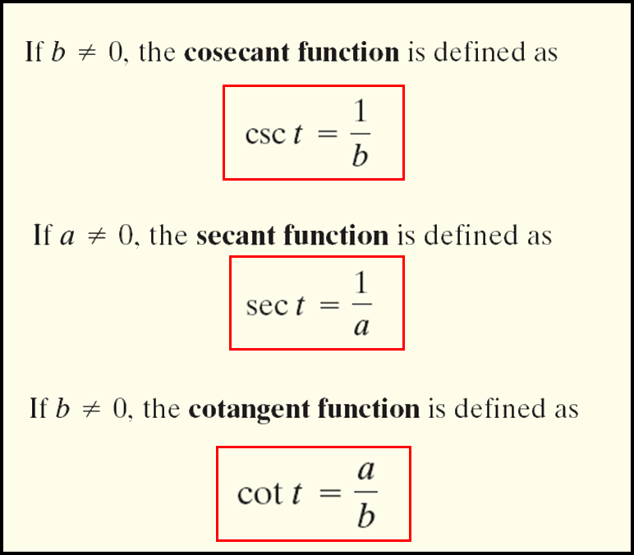
Copyright © 2012 Pearson Education, Inc. Publishing as Prentice Hall.

Slide 6

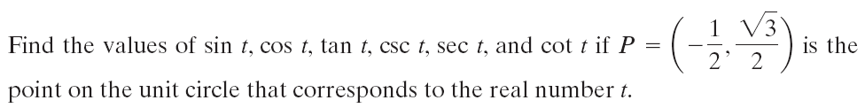
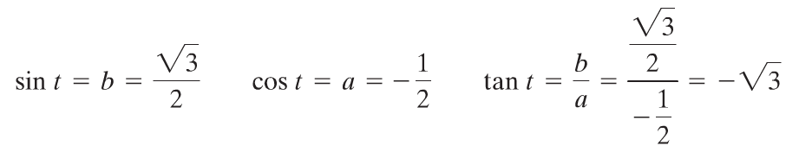
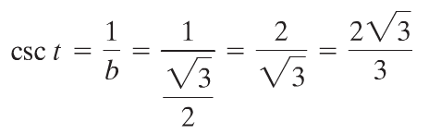
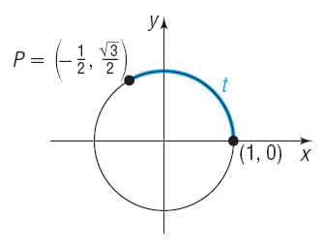
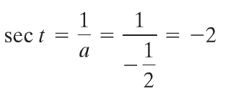
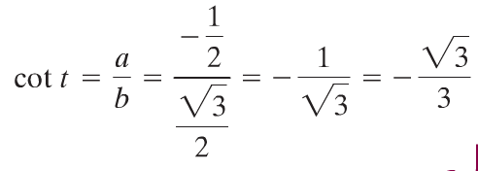
Copyright © 2012 Pearson Education, Inc. Publishing as Prentice Hall.

Slide 7
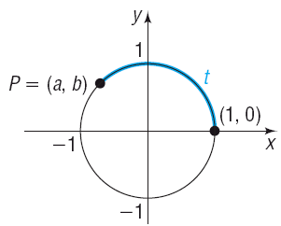
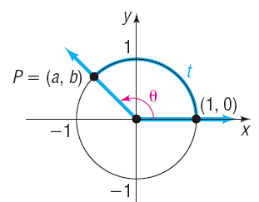
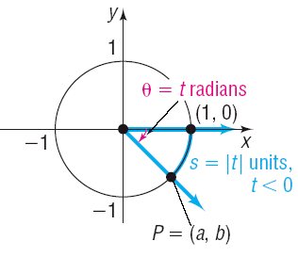
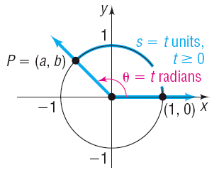
Copyright © 2012 Pearson Education, Inc. Publishing as Prentice Hall.

Slide 8

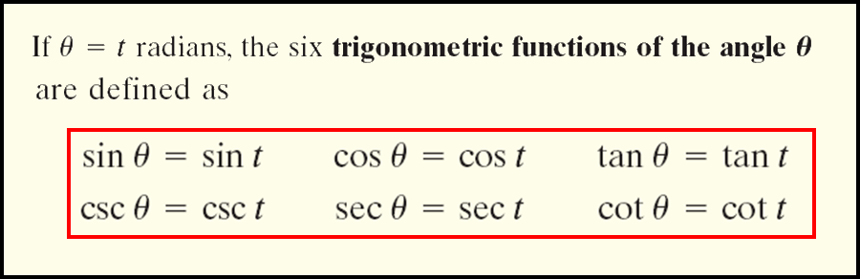
Copyright © 2012 Pearson Education, Inc. Publishing as Prentice Hall.

Slide 9
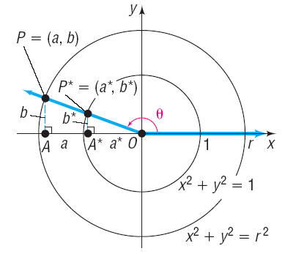

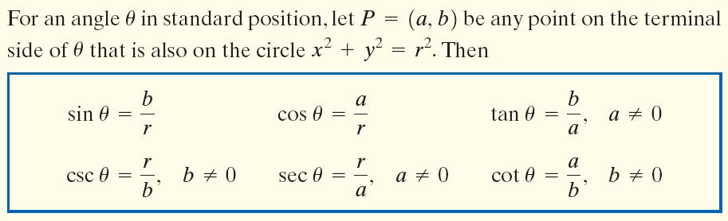
Copyright © 2012 Pearson Education, Inc. Publishing as Prentice Hall.

Slide 10
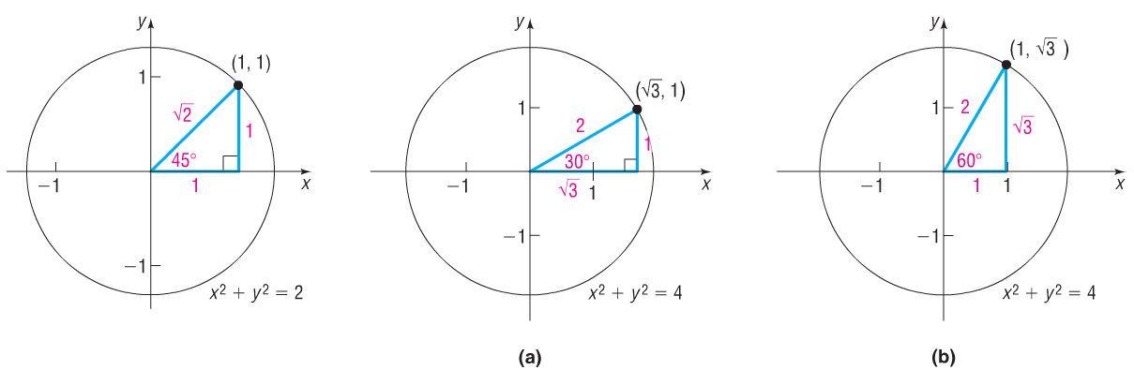
Copyright © 2012 Pearson Education, Inc. Publishing as Prentice Hall.

Slide 11
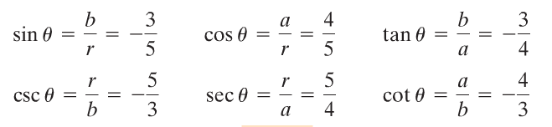
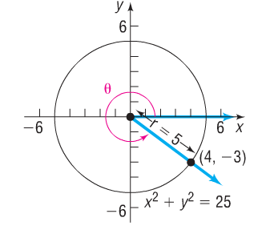
Copyright © 2012 Pearson Education, Inc. Publishing as Prentice Hall.

Slide 12
Copyright © 2012 Pearson Education, Inc. Publishing as Prentice Hall.

Slide 13
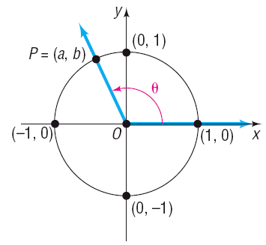
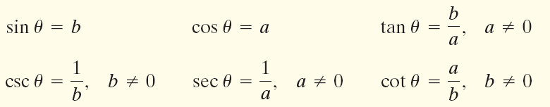
Copyright © 2012 Pearson Education, Inc. Publishing as Prentice Hall.

Slide 14

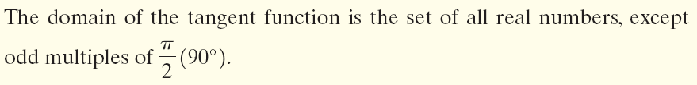
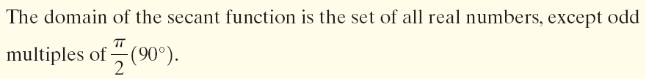
Copyright © 2012 Pearson Education, Inc. Publishing as Prentice Hall.

Slide 15


Copyright © 2012 Pearson Education, Inc. Publishing as Prentice Hall.

Slide 16
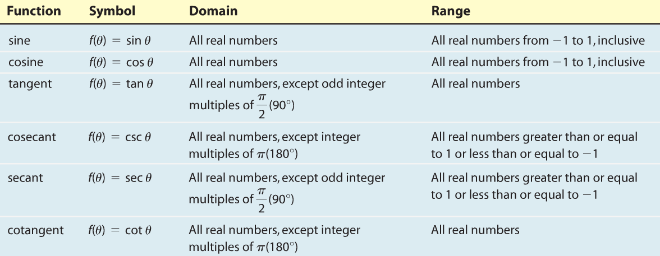
Copyright © 2012 Pearson Education, Inc. Publishing as Prentice Hall.

Slide 17
Copyright © 2012 Pearson Education, Inc. Publishing as Prentice Hall.

Slide 18
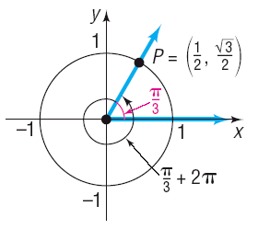
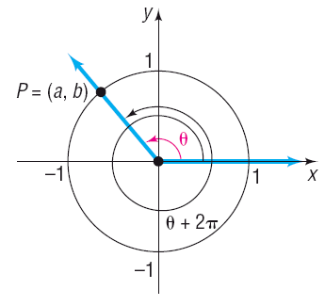
Copyright © 2012 Pearson Education, Inc. Publishing as Prentice Hall.

Slide 19

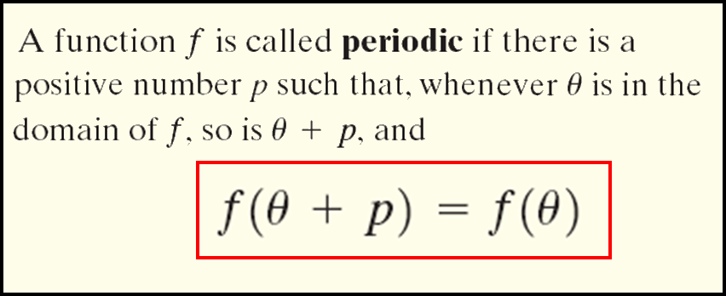
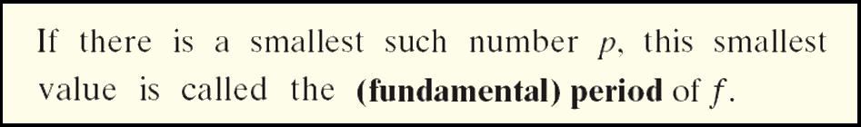
Copyright © 2012 Pearson Education, Inc. Publishing as Prentice Hall.

Slide 20


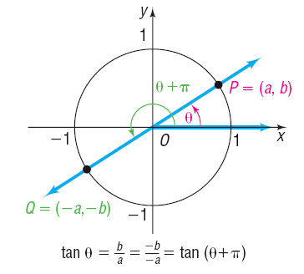
Copyright © 2012 Pearson Education, Inc. Publishing as Prentice Hall.

Slide 21
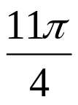

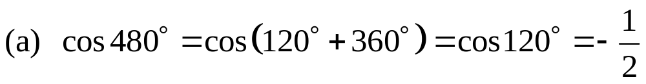
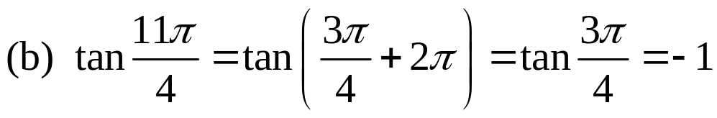
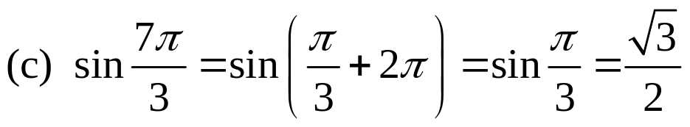
Find the exact value of:
(a) cos 480° (b) tan (c) sin
Copyright © 2012 Pearson Education, Inc. Publishing as Prentice Hall.

Slide 22

Copyright © 2012 Pearson Education, Inc. Publishing as Prentice Hall.

Slide 23


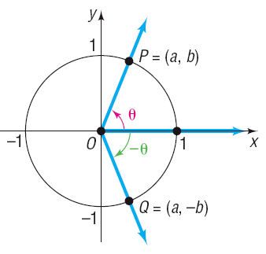
Copyright © 2012 Pearson Education, Inc. Publishing as Prentice Hall.

Slide 24
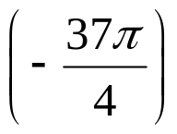
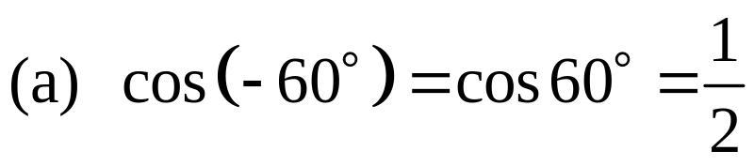
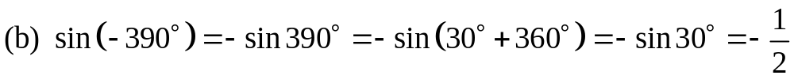
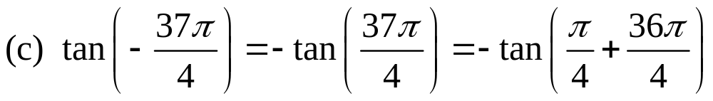
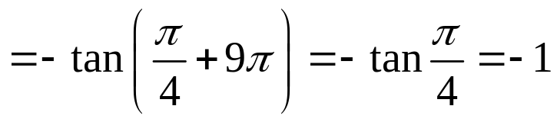
Find the exact value of:
cos (– 60°) (b) sin (–390°) (c) tan
Copyright © 2012 Pearson Education, Inc. Publishing as Prentice Hall.

